Slide 1

EMPLOYEE MANAGEMENT SYSTEM
Presented by:
Mangali Deepika
Munipavani Angadala
Pragathi

Slide 2
Agenda
Objective of the Project
ER Diagram and schema explanation
Employee insights
Job role and department analysis
Qualification and skills analysis
Leave and absence patterns
Payroll and compensation analysis
Challenges working on SQL – Data Analysis Project.

Slide 3
Main Objective of the Project
To manage and organize employee details, job roles, payroll, and leaves efficiently.
To maintain data consistency through a relational database system.
To automate payroll and salary calculations.
To generate useful reports and insights for management decisions.

Slide 4
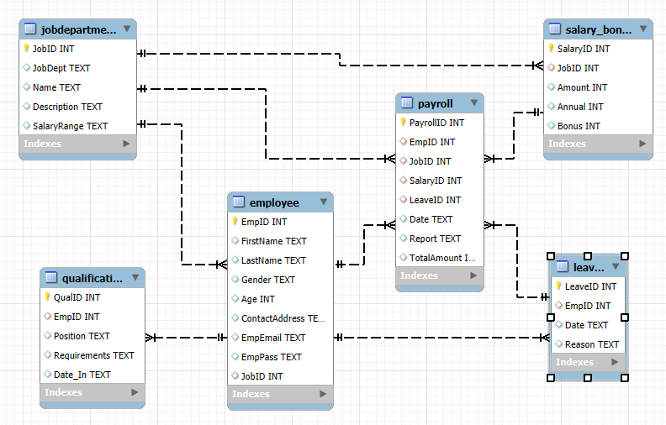
ER DIAGRAM
Represents the relationships between key entities in the Employee Management System.
Shows how employees, departments, salaries, leaves, and qualifications are interconnected.
Helps in understanding the database structure and data flow.
Ensures data integrity through proper primary and foreign key relationships.
Acts as a blueprint for database design and implementation.

Slide 5

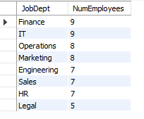
Employee insights
1.a How many unique employees are currently in the system?
SELECT COUNT(DISTINCT EmpID) AS Total Employees
FROM employee;
1.b Which departments have the highest number of employees?
SELECT j.JobDept, COUNT(e.EmpID) AS NumEmployees
FROM employee e
JOIN jobdepartment j ON e.JobID = j.JobID
GROUP BY j.JobDept
ORDER BY NumEmployees DESC;

Slide 6
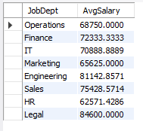
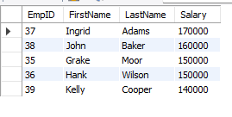
1.c What is the average salary per department?
SELECT j.JobDept, AVG(s.Amount) AS AvgSalary
FROM employee e
JOIN jobdepartment j ON e.JobID = j.JobID
JOIN salary_bonus s ON e.JobID = s.JobID
GROUP BY j.JobDept;
1.d Who are the top 5 highest-paid employees?
SELECT e.EmpID, e.FirstName, e.LastName, s.Amount AS Salary
FROM employee e
JOIN salary_bonus s ON e.JobID = s.JobID
ORDER BY s.Amount DESC
LIMIT 5;

Slide 7

1.e What is the total salary expenditure across the company?
SELECT SUM(s.Amount) AS TotalSalaryExpenditure
FROM employee e
JOIN salary_bonus s ON e.JobID = s.JobID;

Slide 8
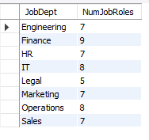
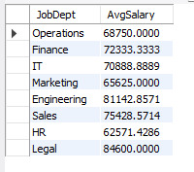
2. Job role and department analysis
2.a How many different job roles exist in each department?
SELECT JobDept, COUNT(DISTINCT Name) AS NumJobRoles
FROM jobdepartment
GROUP BY JobDept;
2.b What is the average salary range per department?
SELECT j.JobDept, AVG(s.Amount) AS AvgSalary
FROM jobdepartment j
JOIN salary_bonus s ON j.JobID = s.JobID
GROUP BY j.JobDept;

Slide 9
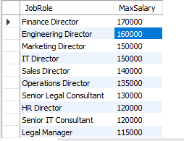
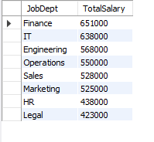
2.c Which job roles offer the highest salary?
SELECT Name AS JobRole, MAX(s.Amount) AS MaxSalary
FROM jobdepartment j
JOIN salary_bonus s ON j.JobID = s.JobID
GROUP BY Name
ORDER BY MaxSalary DESC;
2.d Which departments have the highest total salary allocation?
SELECT j.JobDept, SUM(s.Amount) AS TotalSalary
FROM jobdepartment j
JOIN salary_bonus s ON j.JobID = s.JobID
GROUP BY j.JobDept
ORDER BY TotalSalary DESC;

Slide 10

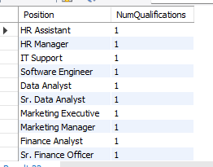
3. Qualification and skills analysis
3.a How many employees have at least one qualification listed?
SELECT COUNT(DISTINCT EmpID) AS EmployeesWithQualification
FROM qualification;
3.b Which positions require the most qualifications?
SELECT Position, COUNT(QualID) AS NumQualifications
FROM qualification
GROUP BY Position
ORDER BY NumQualifications DESC;

Slide 11
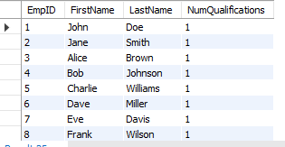
3.c Which employees have the highest number of qualifications?
SELECT e.EmpID, e.FirstName, e.LastName, COUNT(q.QualID) AS NumQualifications
FROM employee e
JOIN qualification q ON e.EmpID = q.EmpID
GROUP BY e.EmpID, e.FirstName, e.LastName
ORDER BY NumQualifications DESC;

Slide 12

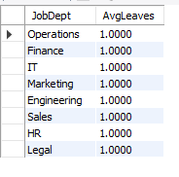
4. Leave and absence patterns
4.a Which year had the most employees taking leaves?
SELECT SUBSTRING(Date, 1, 4) AS Year, COUNT(DISTINCT EmpID) AS NumEmployees
FROM leaves
GROUP BY Year
ORDER BY NumEmployees DESC;
4.b Average number of leave days per department
SELECT j.JobDept, AVG(LeaveCount) AS AvgLeaves
FROM (
SELECT e.EmpID, e.JobID, COUNT(l.LeaveID) AS LeaveCount
FROM employee e
LEFT JOIN leaves l ON e.EmpID = l.EmpID
GROUP BY e.EmpID, e.JobID
) AS emp_leaves
JOIN jobdepartment j ON emp_leaves.JobID = j.JobID
GROUP BY j.JobDept;

Slide 13
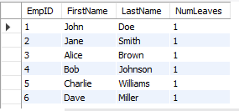

4.c Employees who have taken the most leaves
SELECT e.EmpID, e.FirstName, e.LastName, COUNT(l.LeaveID) AS NumLeaves
FROM employee e
JOIN leaves l ON e.EmpID = l.EmpID
GROUP BY e.EmpID, e.FirstName, e.LastName
ORDER BY NumLeaves DESC;
4.d Total number of leave days company-wide
SELECT COUNT(LeaveID) AS TotalLeaves
FROM leaves;

Slide 14
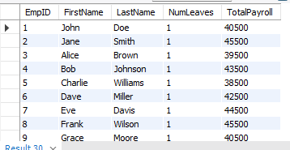
4.e Correlation between leave days and payroll amounts
SELECT e.EmpID, e.FirstName, e.LastName, COUNT(l.LeaveID) AS NumLeaves, SUM(p.TotalAmount) AS TotalPayroll
FROM employee e
LEFT JOIN leaves l ON e.EmpID = l.EmpID
LEFT JOIN payroll p ON e.EmpID = p.EmpID
GROUP BY e.EmpID, e.FirstName, e.LastName;

Slide 15

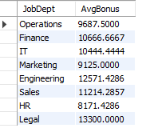
5. Payroll and compensation analysis
5.a Total monthly payroll processed
SELECT SUBSTRING(Date, 1, 7) AS Month, SUM(TotalAmount) AS TotalPayroll
FROM payroll
GROUP BY Month
ORDER BY Month;
5.b Average bonus given per department
SELECT j.JobDept, AVG(s.Bonus) AS AvgBonus
FROM employee e
JOIN jobdepartment j ON e.JobID = j.JobID
JOIN salary_bonus s ON e.JobID = s.JobID
GROUP BY j.JobDept;

Slide 16
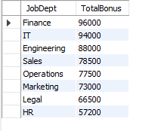

5.c Which department receives the highest total bonuses?
SELECT j.JobDept, SUM(s.Bonus) AS TotalBonus
FROM employee e
JOIN jobdepartment j ON e.JobID = j.JobID
JOIN salary_bonus s ON e.JobID = s.JobID
GROUP BY j.JobDept
ORDER BY TotalBonus DESC;
5.d Average value of total_amount after considering leave deductions
SELECT AVG(TotalAmount) AS AvgTotalAmount
FROM payroll;

Slide 17
Challenges
● Defining correct table relationships and ensuring accurate use of foreign keys.
● Maintaining data consistency with cascading updates and deletes.
● Writing complex joins for reports involving employee roles, leaves, and payroll.
● Ensuring all date fields follow the YYYY-MM-DD format for reliable time-based analysis.
● Preventing duplicate entries using unique constraints, especially on email fields.

Slide 18

THANK YOU

